Slide 1
Active Learning
Yijun Liu
Department of Computer Science
University of Wyoming
Settles, Burr. "Active learning." Synthesis Lectures on Artificial Intelligence and Machine Learning 6.1 (2012): 1-114.

Slide 2
Outline
Introduction
Scenarios (Approaches to Querying)
Query Strategy Frameworks
Theory
Conclusion

Slide 3
Definition
Active learning is a special case of semi-supervised machine learning in which a learning algorithm is able to interactively query the user (or some other information source) to obtain the desired outputs at new data points. In statistics literature it is sometimes also called optimal Experimental design.
Settles, Burr (2010)
Olsson, Fredrik (2009)

Slide 4
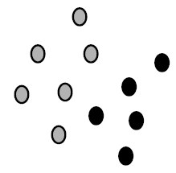
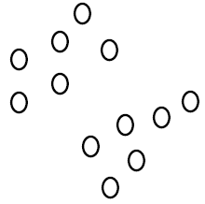
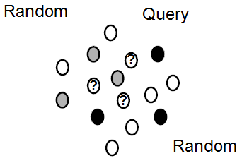
Introduction: Learning paradigms
Supervised Learning
Unsupervised Learning
Active Learning
Notes:
Machine Learning tasks can be supervised learning (classification), unsupervised learning (clustering and model building)
Usually an abundance of unlabeled data. How much should be labeled? Which instances should be labeled?
It matters because of costs: time, money, etc.
• Active Learning: incrementally request labels for instances believed to be informative

Slide 5
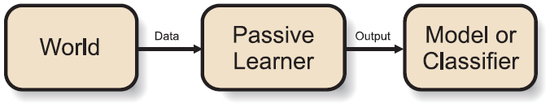
Passive Learning
General Schema of a passive learner
For all supervised and unsupervised learning tasks, it needs to gather significant amount of data randomly sampled from the underlying population distribution and then induce a classifier or model
Cons:
Gathering of labeled data often too expensive: time, money
Notes:
- (To say about the figure) A passive learner receives a random data set from the world and then outputs a classifier or model.
- Often the most time-consuming and costly task in these applications is the gathering of data.
Traditional supervised learning algorithms use whatever labeled data is provided to induce a model. By contrast, active learning gives the learner a degree of control by allowing it to select which instances are labeled and added to the training set.

Slide 6
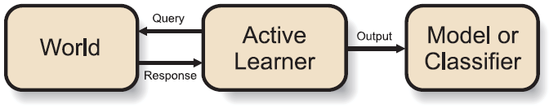
Active Learning
General Schema of a active learner
Difference: the ability to ask queries about the world based on the past queries and responses. The notion of what exactly a query is and what response it receives will depend on the exact task at hand
Pro:
The entire data need not be labeled, it is the task of the learner to request for relevant label
Notes:
(To say about the figure) An active learner gathers information about the world by asking queries and receiving responses

Slide 7
Active Learning Heuristic
Start with a pool of unlabeled data (U)
Pick a few points at random and get their labels using an oracle (e.g. human annotator)
Repeat the following:
Fit a classifier to the labels seen so far
Pick the BEST unlabeled point to get a label for
(closest to the boundary?)
(most uncertain?)
(most likely to decrease overall uncertainty?)

Slide 8
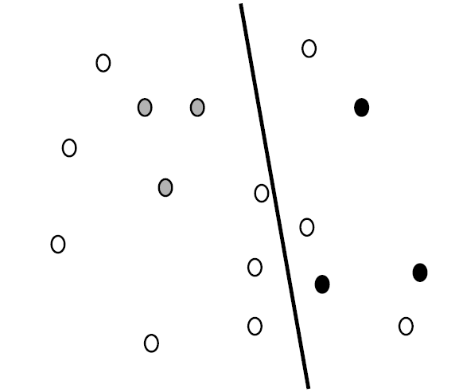
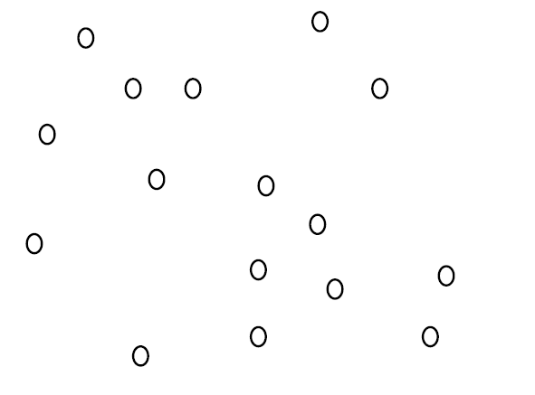
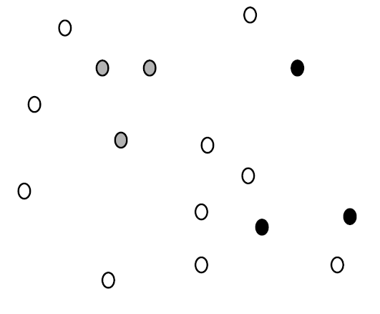
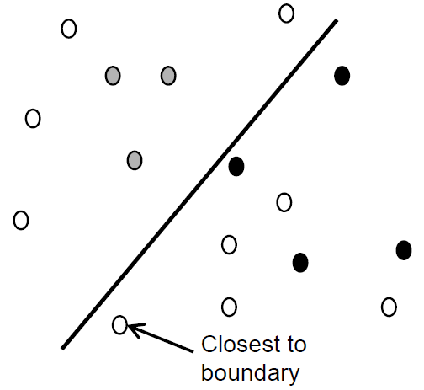
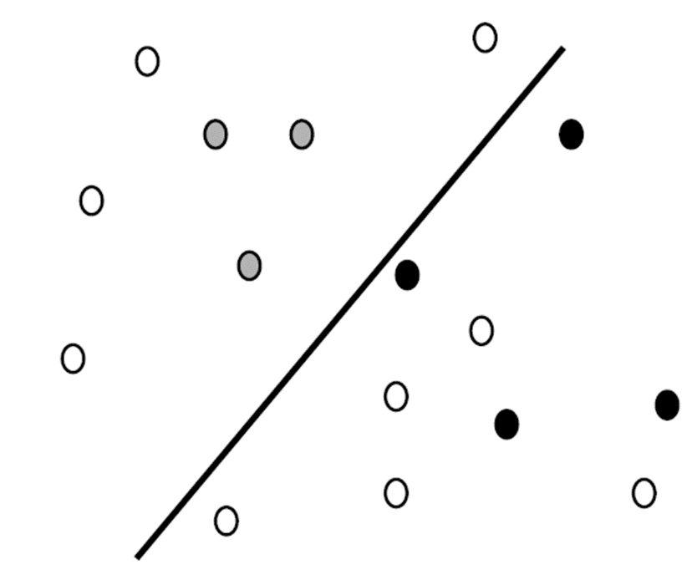
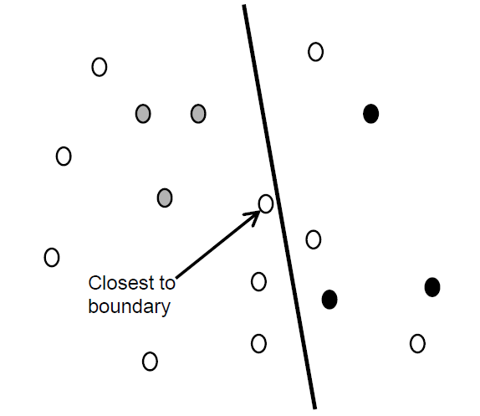
Active Learning
Start: Unlabeled data
Label a random subset
Fit a classifier to labeled data
Pick the BEST next point to label
Fit a classifier to labeled data
Pick the BEST next point to label

Slide 9
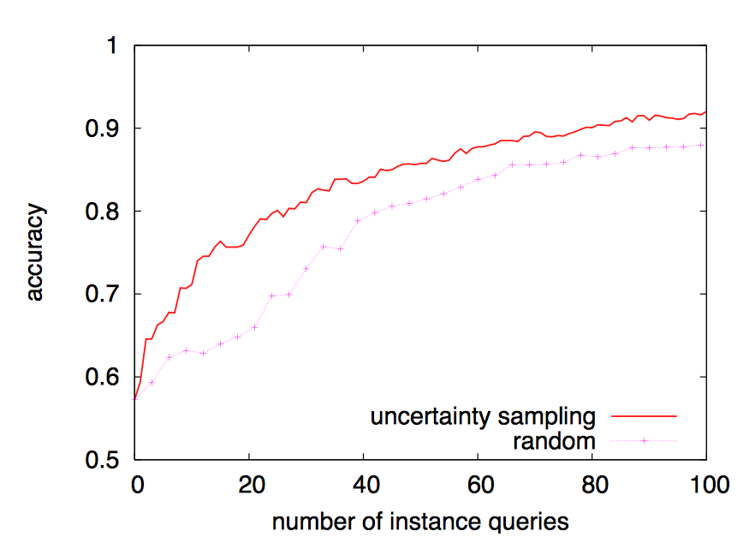
Active learning examples
A.L. well motivated in many modern machine learning problems where data may be abundant but labels are scarce or expensive to obtain
Applications:
Speech recognition
Information extraction
Classification and filtering
Comparison of Uncertainty Sampling (Active Learning) vs Random sampling for text classification of Baseball vs Hockey

Slide 10
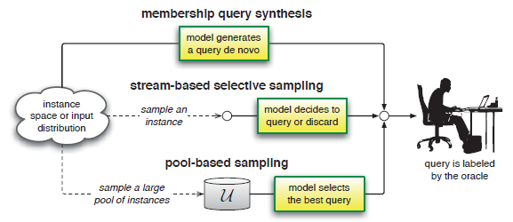
Scenarios (Approaches to Querying)
Three Main Active Learning Scenarios (Settles, 2010)

Slide 11
Membership Query Synthesis
The learner may request labels for any unlabeled instance in the input space, including queries that the learner generates de novo
Pros:
Computationally tractable (for finite domains)
Can be extended to regression tasks
Cons:
Human annotator may have difficulty interpreting and labeling arbitrary instances

Slide 12
Stream-Based Selective Sampling
This approach is called stream / sequential active learning, as each unlabeled instance is typically drawn one at a time from the data source, and the learner must decide whether to query or discard it.
Pros:
Better to use when memory or processing power may be limited, as with mobile and embedded devices.
Cons:
The assumption that the unlabeled data is available free might not always hold.

Slide 13
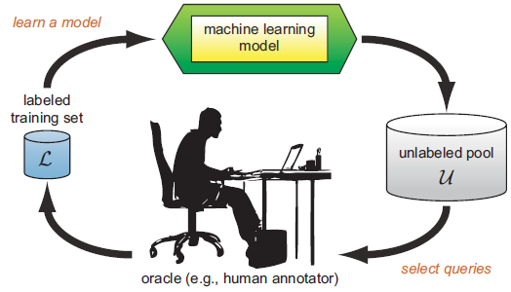
Pool-Based Sampling
The pool-based active learning cycle (Settles, 2010)

Slide 14
Pool-Based Sampling
It assumes that there is a small set of labeled data L and a large pool of unlabeled data U available. The learner is supplied with a set of unlabeled examples from which it can selects queries.
Pros:
Probably the most widely used sampling method (text classification, information extraction, image classification, video classification, speech recognition)
Applied to many real-world tasks
Cons:
Computationally intensive
Needs to evaluate entire set at each iteration

Slide 15
Query Strategy Frameworks
Uncertainty Sampling
Query-By-Committee
Expected Model Change
Expected Error Reduction
Variance Reduction
Density-Weighted Methods

Slide 16
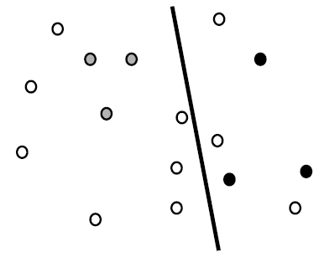
Uncertainty Sampling (I)
An active learner queries the instances about which it is least certain how to label (e.g. closest to the decision boundary)
closest to
boundary
Basically there are 3 strategies: least confident, margin sampling and entropy

Slide 17


Uncertainty Sampling (II)
For problems with three or more class labels: it might query the instances whose prediction is the least confident
The uncertainty measure:
Where is the class label with highest posterior probability under model θ
Pros:
Appropriate if the objective function is to reduce classification error
Cons:
This strategy only considers information about the most probable label

Slide 18



Uncertainty Sampling (III)
Partial solution: margin sampling:
where and are the first and second most probable class labels under the model
Pros:
Corrects the least confident strategy by incorporating the posterior of the second most likely label
Appropriate if the objective function is to reduce classification error
Cons:
For problems with very large label sets, it still ignores the output distribution for the remaining classes

Slide 19

Uncertainty Sampling (IV)
Solution: Entropy
Where ranges over all possible labeling
Entropy is an information-theoretic measure that represents the amount of information needed to “encode” a distribution
Pro:
Generalizes easily the strategy for probabilistic multi-label classifiers and for more complex structured instances (e.g. sequences, trees)
Appropriate if the objective function is to minimize log-loss

Slide 20
Query-By-Committee (I)
The QBC approach involves maintaining a committee C of models which are all trained on the current labeled set L, but represent competing hypotheses
Each committee member votes on the labeling of query candidates
Pick the instances generating the most disagreement among hypotheses
Goal of QBC: minimize the version space (the set of hypotheses that are consistent with the current labeled trained data L), to constrain the size of this space as much as possible with a few labeled instances as possible

Slide 21
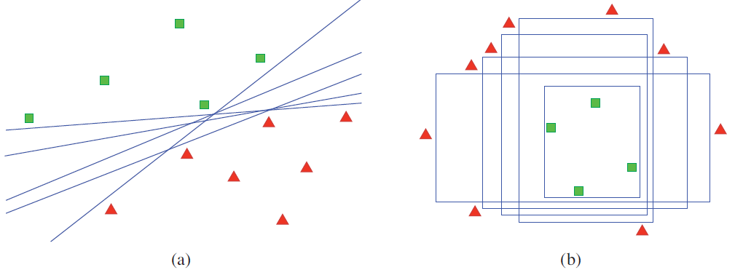
Query-By-Committee (II)
Version space examples for (a) linear and (b) axis-parallel box classifiers. All hypotheses are consistent with the labeled training data in L (as indicated by shaded polygons), but each represents a different model in the version space
To implement a QBC selection algorithm:
Construct a committee of models that represent different regions of the version space
Have some measure of disagreement among committee members

Slide 22


Query-By-Committee (III)
Two approaches for measuring the level of disagreement
1) Vote entropy:
Where ranges over all possible labeling,
is the number of “votes”, C is the committee size
2) Kullback-Leibler (KL) divergence:

Slide 23
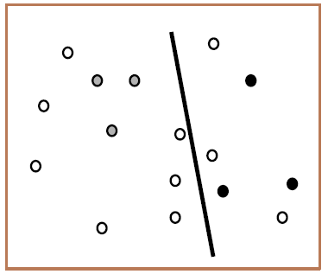
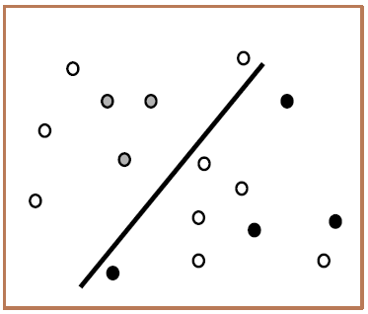
Expected Model Change (I)
Is a decision-theoretic approach
It selects the instance that would impart the greatest change to the current model if we knew its label
Before
After

Slide 24
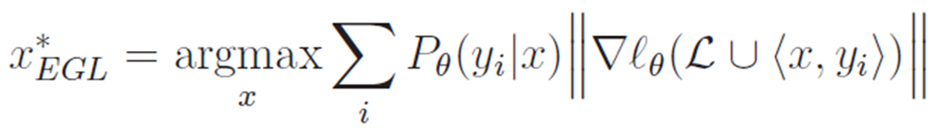


Expected Model Change (II)
Expected Gradient Length (EGL)
It uses gradient-based training
The learner should query the instance x which, if labeled and added to L, would result in the new training gradient of the largest magnitude
It calculates the length as an expectation over the possible labeling:
With the gradient of the objective function ℓ with respect to the model parameters θ
the new gradient that would be obtained by adding the training tuple <x,y> to L

Slide 25
Expected Model Change (III)
It prefers instances that are likely to most influence the model, regardless of the resulting query label
Cons:
Computationally expensive if both the feature space and set of labeling are very large
If features are not properly scaled, EGL approach can be led astray (Solution: parameter regularization)

Slide 26

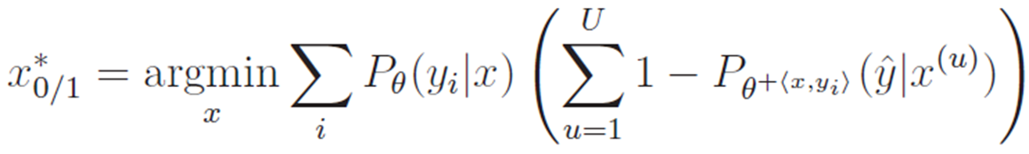

Expected Error Reduction
A decision-theoretic approach
Query the instances that would most reduce error. Measures how much its generalization error is likely to be reduced
The idea it to estimate the expected future error of a model trained using on the remaining unlabeled instances in U, and query the instance with minimal expected future error (risk)
One approach: Minimize the expected 0/1-loss:
Where refers to the new model after it has been re-trained with the training tuple <x,yi> added to L

Slide 27
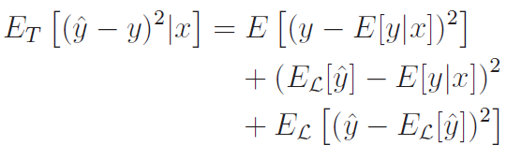
Variance Reduction
Objective: reduce generalization error indirectly by minimizing output variance
Considering a regression problem, the learner’s expected future error can be decomposed:
Noise
Bias
Expectation over both
Variance
Expectation over the labeled set L

Slide 28
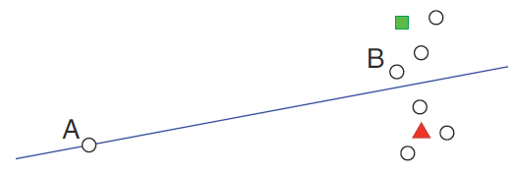
Density-Weighted Methods (I)
Last methods spend time querying possible outliers simple because they are controversial
Figure: Poor strategy for classification when using uncertainty sampling can be a poor strategy for classification. Since A is on the decision boundary, it would be queried as the most uncertain. However, querying B is likely to result in more information about the data distribution as a whole
The basic idea is to query the most “informative” and “representative” (inhabit dense regions of the input space)

Slide 29
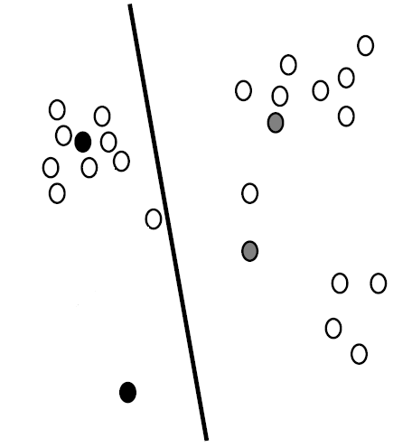
Density-Weighted Methods (II)
1) The information density framework (Settles and Craven, 2008)
Main idea: informative instances should not only be those which are uncertain, but also those which are “representative” of the underlying distribution.
In densest region but still very close to decision boundary
Very close to decision boundary

Slide 30
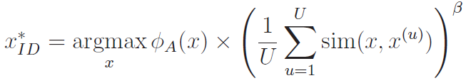
Density-Weighted Methods (III)
The Settles and Craven approach:
Where φA(x) represents the informativeness of x according to some “base” query strategy A, such as an uncertainty sampling or QBC approach. The second term weights the informativeness of x by its average similarity to all other instances in the input distribution (as approximated by U), subject to a parameter β that controls the relative importance of the density term

Slide 31
Density-Weighted Methods (IV)
Pro
If densities can be pre-computed efficiently and cached for later use, the time required to select the next query is essentially no different than the base informativeness measure (e.g., uncertainty sampling)
This is advantageous for conducting active learning interactively with oracles in real-time

Slide 32
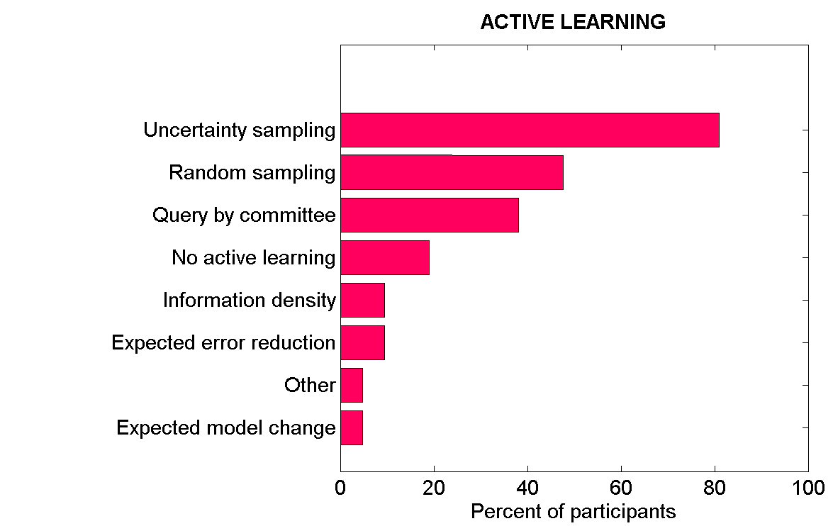
Usage Comparison of Different Active Learning Approach
[Guyon, Cawley , Dror , Lemaire 2009]
[Active Learning Challenge ]
http://www.causality.inf.ethz.ch/activelearning.php#cont

Slide 33


A PAC BOUND FOR ACTIVE LEARNING
Let L be the label complexity, defined as the smallest integer t such that for all t’≥ t
Let D_{XY} denote a joint instance-label distribution, and assume that labeled instances in the training set L~ D_{XY} are i.i.d. samples. If D_{XY} is perfectly separable, i.e., there exists a hypothesis h∗ such that err(h∗) = 0, then the label complexity LPASS of a passive learning algorithm is (Vapnik, 1998):

Slide 34



A PAC BOUND FOR ACTIVE LEARNING
First, the data distribution provides a natural measure of the “difference” △(h1, h2) between any two hypotheses, defined as:
Intuitively, △ encodes the proportion of instances about which the two hypotheses disagree. The r-ball centered at some hypothesis h∗ is defined as:
that is, the set of all hypotheses for which the probability mass under the region of disagreement with h∗ is within radius r. For a given version space V and instance space X, the region of disagreement is defined as:

Slide 35
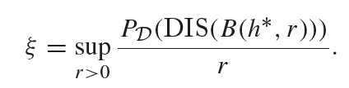
A PAC BOUND FOR ACTIVE LEARNING
Hanneke (2007) proposed a new parameter to characterize the complexity of active learning, as a function of the hypothesis class H and input distribution D. The so called disagreement coefficient ξ measures how the probability of disagreement with h∗ scales with r:
Roughly speaking, ξ attempts to quantify how quickly the region of disagreement grows as a function of the radius of the version space. Hence, smaller values of ξ imply more efficient shrinkage of the version space.

Slide 36
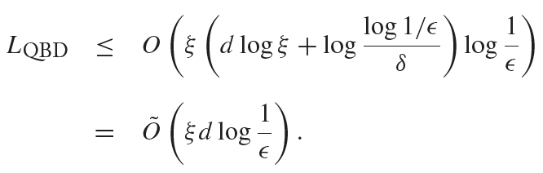
A PAC BOUND FOR ACTIVE LEARNING
Theorem 6.2 Suppose H has finite VC dimension d, and the learning problem is separable with disagreement coefficient ξ .Then the label complexity LQBD of the query by disagreement algorithm is (Hanneke, 2009):

Slide 37
Conclusion
Active learning is a growing area of research in machine learning backed by the fact that the data available is ever growing and is available for less
A lot of the research is involved in improving the accuracy of the learner with lesser number of queries
Current day research is intended at implementing active learning in practical scenarios and problem solving

Slide 38
Thank you

